Slide 1
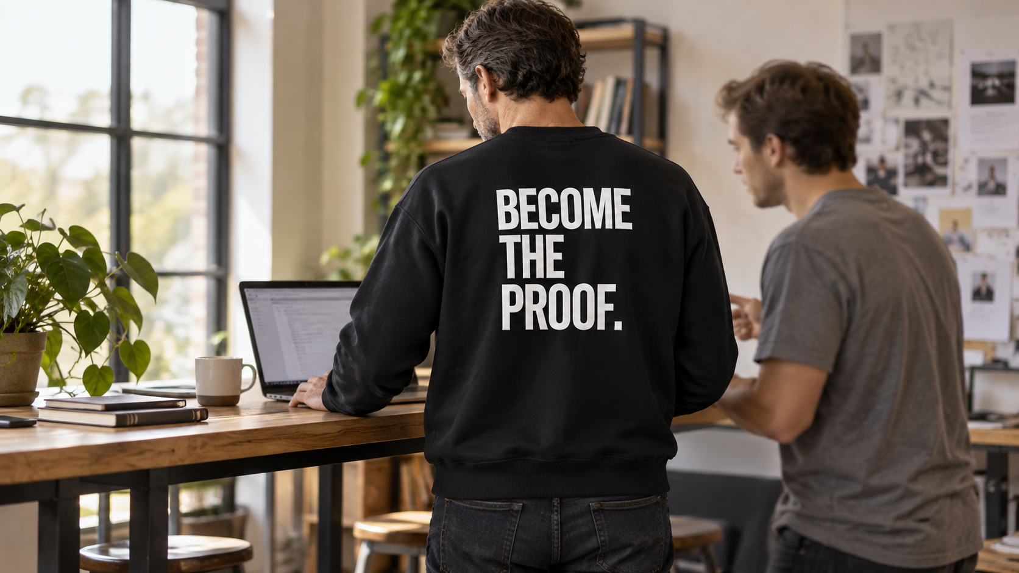

JSB MEDIA
Become the Proof
Collection 001
Launch strategy & creative directions
Prepared for BTP
October 2026
Concept visualization. Garment appearance is illustrative.
01

Slide 2
WHY JSB
Why JSB is the right partner
What you told us | How JSB answers it
A launch that does not scramble | A roadmap paced by readiness, with a named owner for each stage.
A partner who understands the strategy | Strategy and concepts come first, before any fee, so you judge the thinking.
One team, not a chain of vendors | Strategy, casting, creator briefing, production and paid media run in house, under one team.
Fast to adapt, not set and forget | AI-assisted production takes a brief to a finished cut in days, so tests run on real volume.
Proof from categories like yours | Case studies follow across apparel and lifestyle, premium product, social, hospitality and skincare.
Honest about limits | We do not place product with store buyers. We plan events, pop-ups and the launch itself.
Client examples are from JSB case studies and reporting; results as reported.
02

Slide 3


BRAND FOUNDATION
The meaning behind the name
Possibility, demonstrated
Ambition and discipline become visible through action.
The creative expression
Show a specific action in someone’s current chapter, with BTP worn naturally.
The role of the garment
An expression of the outlook behind the work.
Concept visualization. Casting, locations and garment appearance are illustrative.
03

Slide 4
THE PREMIUM CASE
The premium is the material
Material carries the price
The heavyweight crewneck earns its price on fabric, weight, finish and construction. The creative shows those first, before any lifestyle.
Premium, not streetwear
The brief is explicit: a premium contemporary label, not motivational merchandise or trend-driven streetwear. Routes that read as merch or hype get cut.
Proof over vague premium
Buyers judge a premium piece on fit, fabric and how it holds up. Product pages and creative answer those questions with real sample photography.
Positioning language from the client-supplied creative brief, p. 02. Product claims require verified sample facts.
04

Slide 5
OUR RECOMMENDATION
The launch opportunity
A story people can recognize
A real action, a specific person and a reason it matters to them.
A garment people can evaluate
A clear view of the crewneck, its fit, finish and statement.
A buying experience people can trust
Accurate product information and a direct path to BTP’s own store.
05

Slide 6

AUDIENCE
The first buyer to validate
Working hypothesis
An adult considering premium crewnecks who likes the silhouette and statement.
The emotional connection
A person who identifies with ambition expressed through action.
The validation
Validate the garment, actual price and purchase intent before scaling.
Concept visualization. Casting, locations and garment appearance are illustrative.
06

Slide 7
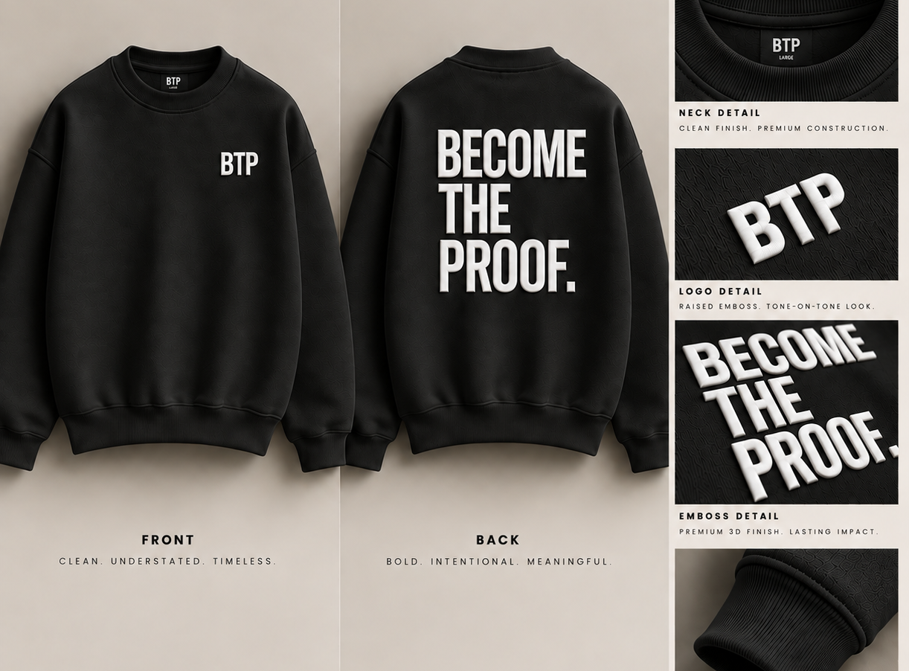
PRODUCT FOUNDATION
Collection 001 remains the hero
THE PROLIFIC /001
The existing heavyweight crewneck anchors the launch.
Front and back
Keep the quiet chest mark and the raised back statement visible in the content.
Sample first
Confirm fit, material, finish and approved product facts before the shoot.
Supplied design reference. Final sample, colours and specifications to be confirmed.
07

Slide 8
PROPOSED JSB PARTNERSHIP
A connected launch plan
Workstream | Launch contribution
Creative direction | One lead campaign with a distinct visual idea
Content & distribution | An original asset bank adapted to each channel
Organic & community | A publishing rhythm, creator participation and email
Paid media | Controlled creative tests with commercial guardrails
Ecommerce & outlets | An owned-store path plus eligible discovery channels
Account management | Named owners, approvals and reporting
Scope and staffing are proposed for discussion. Final responsibilities will be agreed together.
08

Slide 9
CAMPAIGN OPTIONS
Three creative directions
01
02
03
This Ad Is Still
Being Made
No Audience
Required
Credits
Before Fame
A public canvas that reveals the work while it happens.
The rehearsal matters before anyone is watching.
Give current work the scale and attention of a title sequence.
09

Slide 10
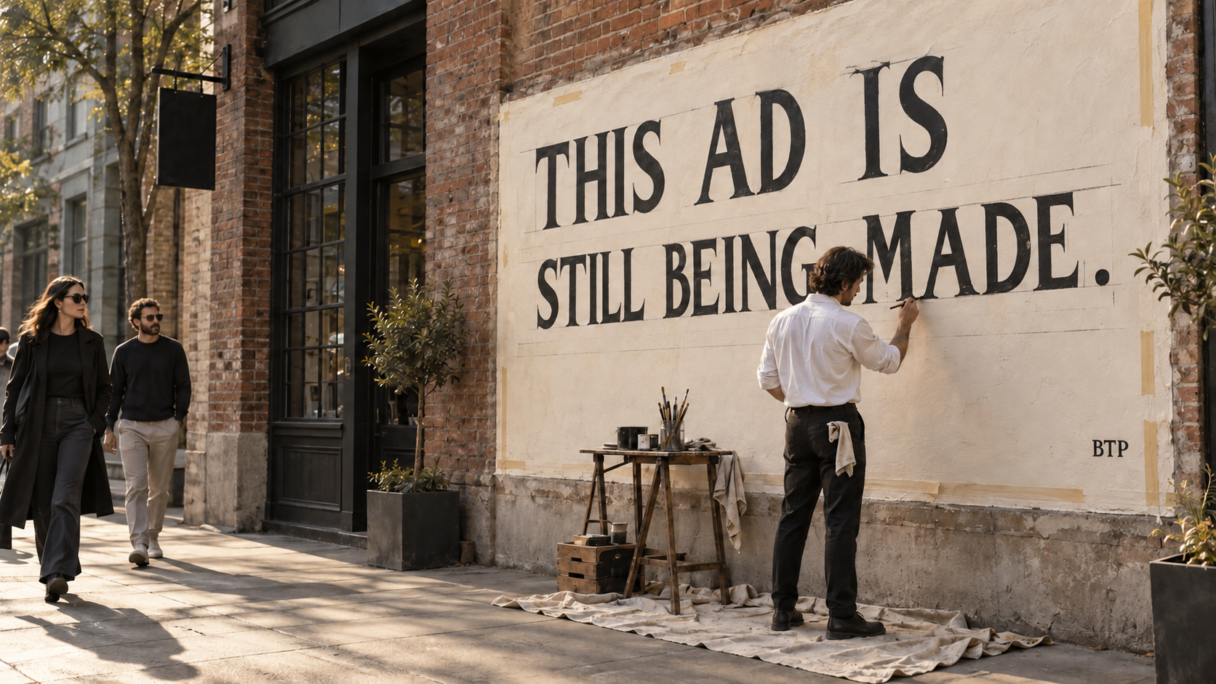
CREATIVE DIRECTION
This Ad Is Still Being Made
The idea
An artist makes the campaign in public, with the process left visible.
The first execution
A paid artist wearing BTP, a permitted window and a filmed session.
The distribution
Window, process films and creator posts linked to Collection 001.
Concept visualization. Casting, locations and garment appearance are illustrative.
10

Slide 11

CREATIVE DIRECTION
No Audience Required
The idea
A performer in BTP rehearses in an empty theatre.
The film
Close on the effort, reveal the empty room, then a clear BTP portrait.
The distribution
Hero film, short vertical edits and portraits tied to the crewneck.
Concept visualization. Casting, locations and garment appearance are illustrative.
11

Slide 12

CREATIVE DIRECTION
Credits Before Fame
The idea
Give someone’s present work the attention of a title sequence.
The execution
A portrait in BTP, a name and the specific work they are doing now.
The distribution
Film credits, street posters, social portraits and product-linked profiles.
Concept visualization. Casting, locations and garment appearance are illustrative.
12

Slide 13

OUR RECOMMENDATION
The recommended starting scope
The garment
Capture the approved sample in motion, in detail and from both sides.
One lead campaign
Select the route that best fits BTP’s cast, resources and launch readiness.
One useful extension
Add a creator, location or physical activation when it strengthens that route.
Concept visualization. Casting, locations and garment appearance are illustrative.
13

Slide 14
CONTENT STRATEGY
Four content pillars
Pillar | What the audience sees
Current chapters | A specific action and the person behind it
Collection evidence | The real sample, material, finish and construction
Wear & fit | Front, back, movement and honest sizing guidance
Access & ownership | Launch information, store answers and wearer stories
Each story connects to the existing collection. Product claims require verified sample facts.
14

Slide 15
ORGANIC STRATEGY
An organic editorial week
Original | Editorial purpose | Adaptation
Video 1 | A current-chapter story | Reel + native TikTok edit
Video 2 | Fit, detail or product answer | Reel + native TikTok edit
Video 3 | Process or campaign episode | Reel + native TikTok edit
Still / carousel | Portrait, garment or useful detail | Instagram + owned-store use
Proposed four-week bank: 12 original videos + 4 original still/carousel stories. Stories adapt this bank.
15

Slide 16
CONTENT & DISTRIBUTION
Distribution with a purpose
Channel | Role | Publishing approach
Instagram | Visual home and product evaluation | Reels, portraits, detail carousels, Stories
TikTok | Discovery and native explanation | Human openings, process and replies
Email & store | Access, answers and purchase | Launch messages and product-linked stories
Creator accounts | Credible individual perspective | Separate paid distribution agreement
Paid media | Controlled reach and conversion tests | Selected derivatives with usage rights
Channel roles are recommendations to test. Adapt the opening, pacing and caption for each placement.
16

Slide 17
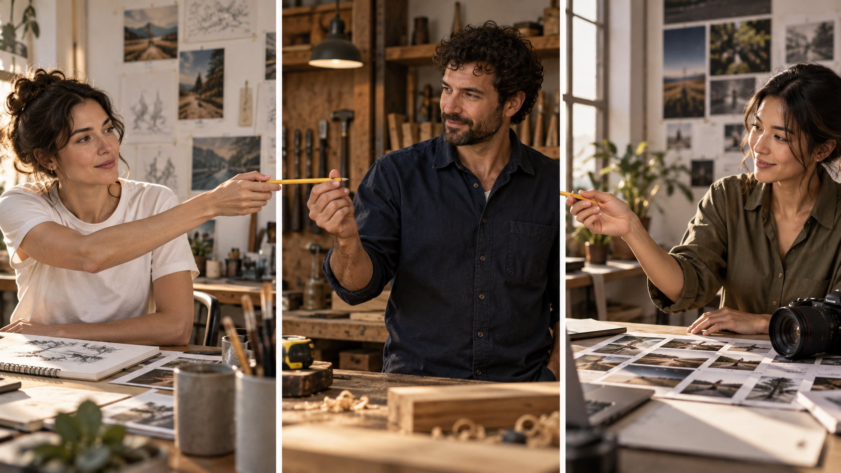
ORGANIC & CREATORS
Creator participation
A useful invitation
Show one action you are repeating, making or learning now.
The brand connection
Wear the approved BTP piece and show the garment clearly.
The agreement
Price production, creator posting and paid usage separately.
Concept visualization. Casting, locations and garment appearance are illustrative.
17

Slide 18
PAID MEDIA
Paid channel recommendations
Priority | Channel | Recommended use
First test | Meta | Test garment-led stories and product evaluation
Conditional test | TikTok | Use native video when creative and budget support it
Demand capture | Google | Relevant search demand and an accurate product feed
Later option | Pinterest | Test once visual assets and purchase signals justify it
Separate extension | Digital out of home | A local creative execution with a distinct budget
Allocate against an agreed test budget and loss limit. No channel performance is assumed.
18

Slide 19
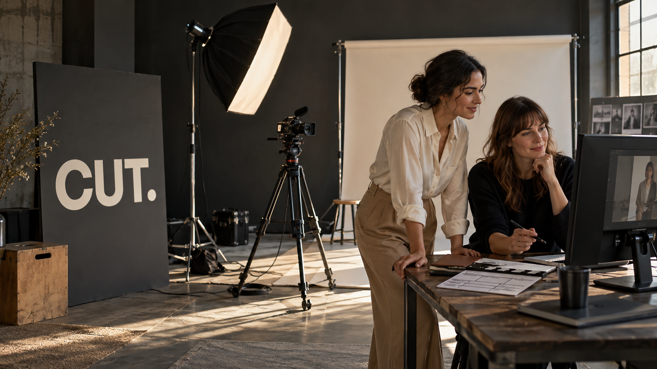
PAID MEDIA
The first paid creative test
Six test derivatives
Two videos with two opening cuts each, plus two still variants.
A clear opening
Show product and premise in the first 1.5 seconds, without sound.
The comparison
Keep price, offer and destination consistent. Review spend, orders and stock.
Concept visualization. Casting, locations and garment appearance are illustrative.
19

Slide 20
ECOMMERCE SETUP
BTP’s owned-store experience
A useful product page
Approved sample photography, front and back, fit guidance, final price and clear product facts.
A complete buying path
Stock, payments, delivery, returns and customer support tested before launch traffic.
A stack that fits BTP
BTP's own website is the only purchase destination. Platform choice stays with BTP; we advise on the product page, checkout and tracking.
Founding Access can offer private early access. Benefits and availability must be defined before promotion.
20

Slide 21
ECOMMERCE OUTLETS
Commerce outlets and discovery
Outlet | Launch role | Readiness condition
Owned store | Primary purchase destination | Tested checkout, policies and fulfilment
Meta catalog | Product discovery to BTP’s website | Supported market, account and catalog eligibility
Google free listings | Additional product discovery | Eligible, accurate feed and policy details
Physical retail / pop-up | Optional experience and product trial | Venue, stock, staffing and costs agreed
Platform access and listing visibility are conditional. No wholesale placement is included.
21

Slide 22
OPERATING MODEL
Account ownership and management
Responsibility | BTP | Proposed delivery owner
Assets, billing, recovery | Owns and controls | JSB receives scoped access
Calendar and publishing | Approves brand and product facts | Assigned social lead
Paid media and reporting | Approves budget and guardrails | Assigned media lead
Store implementation | Names accountable operator | Named implementer, as scoped
Orders, returns and service | Owns customer resolution | BTP service / fulfilment operator
Named people, coverage hours, approval timing and escalation paths are agreed before work begins.
22

Slide 23
ROADMAP
A launch roadmap, paced by readiness
Align · 2 wks
Build · 3–6 wks
Learn · 2–4 wks
Sell & improve · ongoing
Promotion continues throughout, from week 1, at the pace BTP chooses
Stage | Work | Ready when
Align | Align on strategy, scope and needs | Strategy, scope and owners agreed
Build | Capture content and prepare the buying path | Assets, rights, catalog and checkout approved
Learn | Publish, invite access and run a controlled test | Tracking works and response informs revisions
Sell & improve | Open the collection and review results | Inventory and service can support demand
Durations are indicative, not to scale. Assumes sample and price sign-off by the end of Build; any slip moves the later stages.
23

Slide 24
MEASUREMENT
Measurement that informs decisions
Question | Evidence | Decision
Does the story connect? | Viewing, saves, replies and qualified visits | Which story and opening to develop
Does interest become intent? | Confirmed access signups and product-page activity | Which questions and objections to answer
Does the store convert? | Completed orders, returns and net revenue | Where buying friction needs attention
Can spend make sense? | New-customer acquisition cost and contribution | Whether to hold, revise or expand spend
Store orders anchor reporting. Platform attribution can overlap and does not establish incremental sales.
24

Slide 25



Perry Ellis International
Case study

Slide 26

Perry Ellis International
Brought to Life
Perry Ellis International runs a portfolio of licensed apparel and lifestyle labels. We launched and marketed campaigns for more than 20 of them, and the job was the same on every one: move a name on a label into a brand people want to live in. Each was built at the lifestyle forefront rather than sold on product features, with that idea carried across every touchpoint a shopper actually meets. Print, out of home, digital and social ran as one campaign, not four.

Slide 27

Slicing Gear
Case study

Slide 28


Scoring more Revenue
Cutting Edge Campaign
A knife brand wanted to grow the business but from a challenger position, with a small budget. We created a disruptive strategy that leveraged product placement solution in one of the most popular TV shows at the time, and created a bundle product offer, which allowed brand to charge a premium for a collectable set. These bold moves cut out new market segments and sharpened the brand’s position.

Slide 29




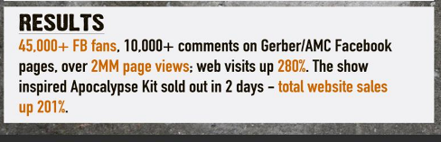
Activities
Strategic partnership with a hugely popular TV show
Co-branded content across digital, social & video
Custom product line inspired by the show
45K +
10K +
100%
Facebook fans
Comments on partner FB
pages
of custom show-inspired kits sold out in 2 days
2M
280% +
201% +
Webpage
views
Increase in unique site visits
Increase in online sales

Slide 30
Small Car
Case study

Slide 31
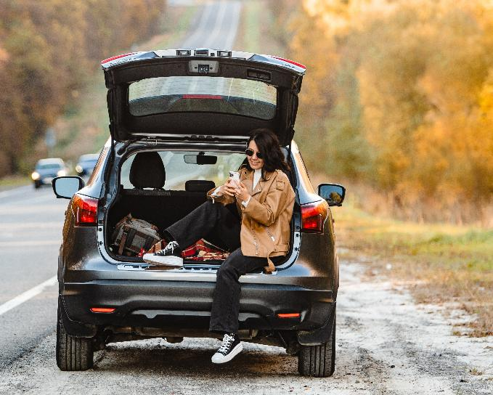
Small Car
Small car, big boost
A compact car brand wanted to spur sales during the holidays, a slow sales month and competitive season in media. We developed a thought-provoking social media strategy to spark interest in the brand through a resonating message about overconsumption.

Slide 32
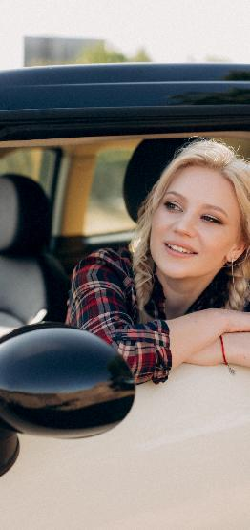



Activities
Dedicated fan page with custom video and share tool for users to upload pics.
Targeted Facebook campaign called Against Dumb.
A contest incentive offering users the chance to win a compact car.
Results
762% +
150% +
Growth in 8 weeks
Growth in sales for slow month
211% +
“Best Use of Social Media”
Cannes Shortlist for
Growth in average daily users

Slide 33
Leading Caribbean Hotelier
Case study

Slide 34

Leading Caribbean Hotelier
A prominent Caribbean hotel group was experiencing high customer acquisition costs, paying around 30% higher per booking inquiry while only converting 10% into actual reservations. This low conversion rate made marketing spend inefficient and unsustainable. To improve results, the hotel group adopted a strategic approach combining guest profile enrichment, retargeting, and smart audience segmentation. By prioritizing quality over quantity, they were able to attract better-fit travelers who were more likely to book stays. This shift not only boosted conversion rates but also laid the foundation for stronger long-term guest relationships and improved return on marketing investment.

Slide 35



<*>
Activities
Profile Enrichment
Used guest data for proper lead info
Retargeting
We focused on site visitors who abandoned
Audience optimization
Focused on data to help push proper target upsell
Results
Improved long-term SEO rankings
Lead cost dropped
Decline by 18% in just 60 Days
enhancing brand visibility
Helped to Drive Higher organic lead volume
Helped increase revpar and increased profit margin

Slide 36

Karuna Skin: two skincare lines, one feed worth stopping
Case study

Slide 37
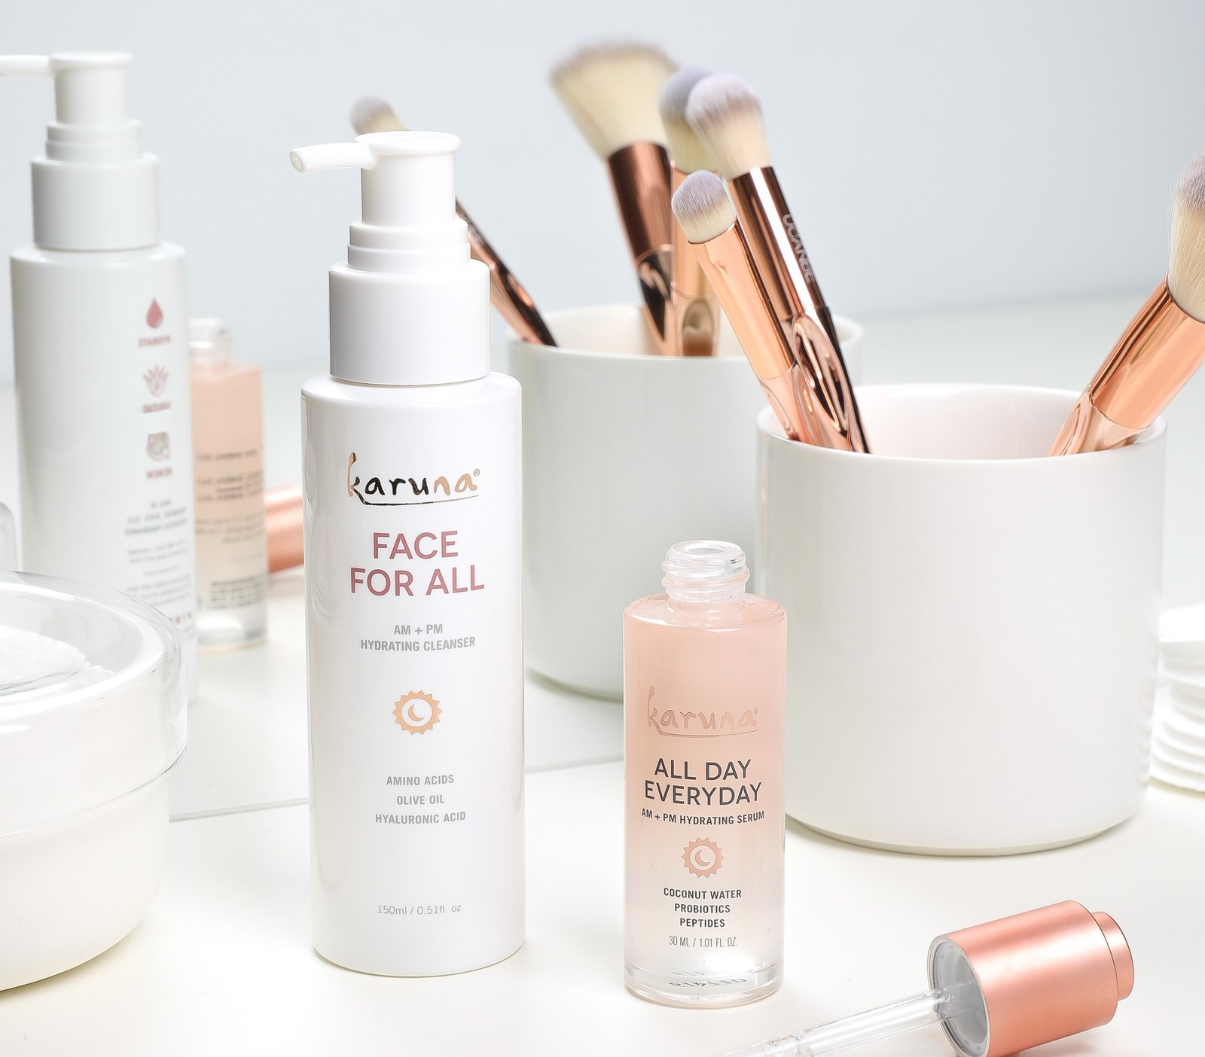
Karuna Skin
Stop the scroll
Karuna Skin had two strong products and a crowded feed. The brief: get the Revivify+ masks and AM+PM hydrating line in front of new buyers on a modest budget. Retargeting closed people who knew the brand, native and video built cheap awareness, and search caught shoppers already looking. Video led on engagement. Beyond Karuna's assets, we built extra creative to test hooks, cutdowns and formats, so the data could show what stops the scroll and what sells.

Slide 38
RESULTS
Bigger reach, more orders
Karuna Skin: AM+PM and Revivify+ paid media
2.8x
More people in the feed
Impressions grew from 4.2MM to 11.9MM
1.9x
More people on the site
Site users rose from 12,400 to 23,321
+57%
More orders
AM+PM transactions, latest flight vs the one before
22%
AM+PM in the top sellers
Share of revenue across the top 25 products
JSBMedia
Source: Karuna Skin paid media reporting (ad platform and Shopify data).

Slide 39
HOW WE START
Ideas first, then costs
Strategy and concepts up front
We bring the strategy and creative concepts before any fee is proposed. Scope and price follow once you have seen the thinking.
Sweat equity up front
We put our own time into that first round so you can judge the work itself. What the first round includes is agreed in writing before we start.
Your partner in the room
Your partner joins the working channel and the monthly review, sees every roadmap update, and gets the same briefings you do before anything goes out.
Scope of the first round to be confirmed before work starts.

Slide 40
PROPOSED ENGAGEMENT
A scope built around the launch
Core launch partnership
Strategy, one lead creative direction, content planning, organic management, paid test management and reporting.
Defined implementation scope
Sample capture, asset production, store work, lifecycle setup and account configuration receive named deliverables.
Separately priced investment
Working media, creator fees and rights, production, technology and any physical activation.
Final scope, delivery owners and investment follow the selected route and confirmed launch requirements.
40

Slide 41
NEXT STEPS
Align on strategy, scope and needs
Align on strategy, scope and needs (2 weeks)
Review the strategy and concepts already shared, choose the lead route, agree scope and what BTP needs, and name the owners on each side.
Commercial foundation
Confirm the sample, price, initial market, inventory and buying path.
Launch partnership
Agree the investment range and accountable owners, then finalize a priced scope.
41

Slide 42
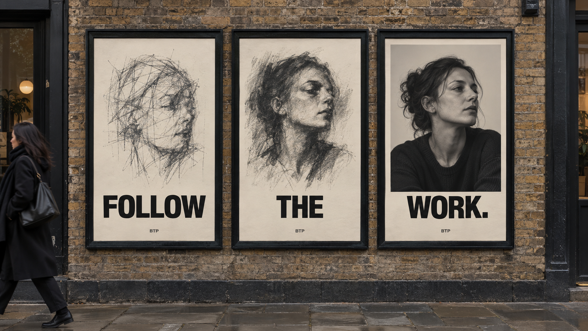
APPENDIX • ACTIVATION OPTION
Paper Trail
The idea
Three posters show the drafts and attempts behind one finished piece.
The activation
A licensed three-poster run with a QR link to the full process and the collection.
The connection
The same person wears BTP throughout the process story.
Concept visualization. Casting, locations and garment appearance are illustrative.
42

Slide 43
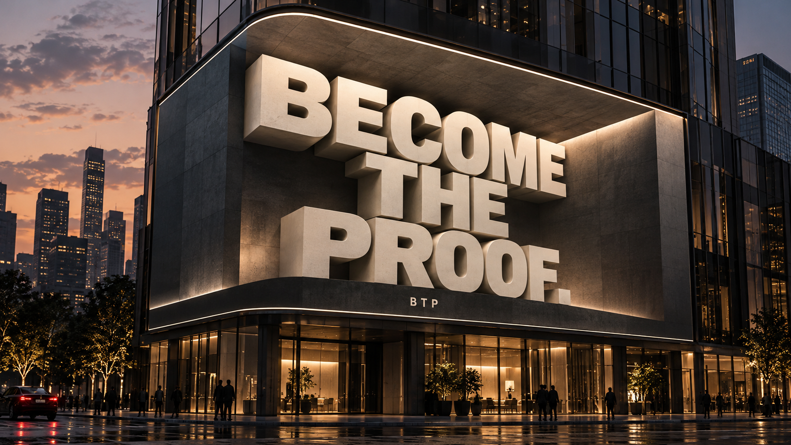
APPENDIX • OUTDOOR OPTION
The Statement Leaves the Shirt
The idea
Scale the back statement into a dimensional outdoor composition.
The execution
A digital out-of-home film or a commissioned physical installation.
The connection
Pair the enlarged statement with an actual crewneck portrait in the final ad.
Concept visualization. Casting, locations and garment appearance are illustrative.
43

Slide 44

APPENDIX • PRINT OPTION
The Working Issue
The idea
A BTP print edition about work in progress, with portraits and unfinished process.
The distribution
A commissioned edition for studios, events or stores that agree to host it.
The connection
Every story pairs a person’s action with an honest view of Collection 001.
Concept visualization. Casting, locations and garment appearance are illustrative.
44

Slide 45
APPENDIX • COMMERCE
Store readiness checklist
Area | Required before launch traffic
Product | Approved samples, final specifications, sizes, prices and stock
Checkout | Working payment, mobile purchase test and confirmation
Operations | Delivery costs, returns process and named support owner
Measurement | Consented tracking where applicable, test order and source tagging
Discovery outlets | Market eligibility, catalog accuracy and permissions checked
The accountable operator signs off each area before paid purchase campaigns begin.
45

Slide 46
APPENDIX • PROPOSED FOUR-WEEK BANK
Content and management scope
Deliverable | Planning basis
Original social content | 12 videos + 4 still/carousel stories
Channel adaptations | Instagram, TikTok and Stories edits of that bank
Paid test derivatives | 4 video cuts + 2 still variants, separate from originals
Owned email | 2 launch emails + 5 lifecycle messages
Management rhythm | Monthly planning, weekly review and agreed community windows
Product photography, creator posting, usage rights, site development and event production are separately scoped.
46

Slide 47
APPENDIX • REFERENCE
Sources and planning assumptions
Brand direction
BTP Collection 001 creative brief and founder meaning clarification, October 2026.
Platform mechanics
Shopify Help for Meta. Google Merchant Center free listings. TikTok Spark Ads. Accessed October 16, 2026.
Proposal boundaries
Buyer, channel mix and delivery scope are hypotheses and recommendations. Sample, pricing, inventory, market eligibility and investment require confirmation.
Visuals
Concept scenes are generated visualizations. Supplied garment artwork remains the product reference.
47

